Slide 1

MEMORY Virtualization

Slide 2
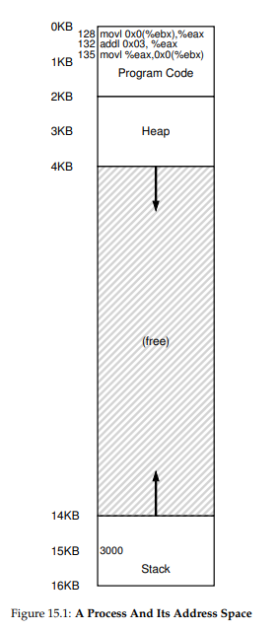
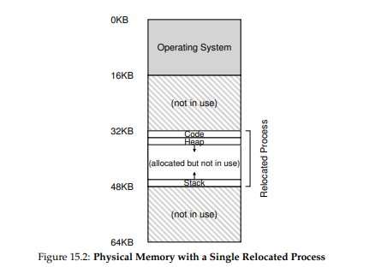
MEMORY Virtualization
예전 메모리 체계

Slide 3
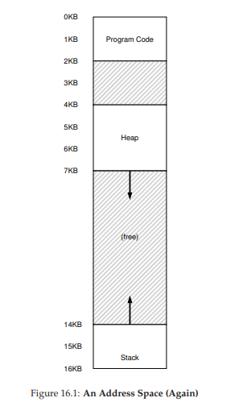
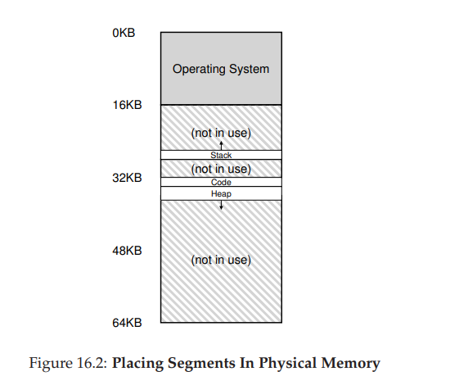
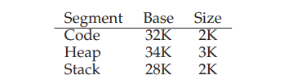
MEMORY Virtualization
Segmentation 나온 후 메모리 체계

Slide 4
MEMORY Virtualization
Free Space Management
Splitting and Coalescing
Basic Strategies
Best Fit
Worst Fit
First Fit
Next Fit
Segregated Lists
Buddy Allocation

Slide 5
Homework of OSTEP
Chap 14. Memory API
메모리 관련 이슈 (dangling pointer , buffer overflow, aliasing)를 gdb, valgrind 도구를 사용한 debugging
Chap 15. Address Translation
segmentation 이 없을 때의 virtual memory 와 physical memory simulation
Chap 16. Segmentation
segmentation 이 생긴 후 virtual memory 와 physical memory simulation

Slide 6
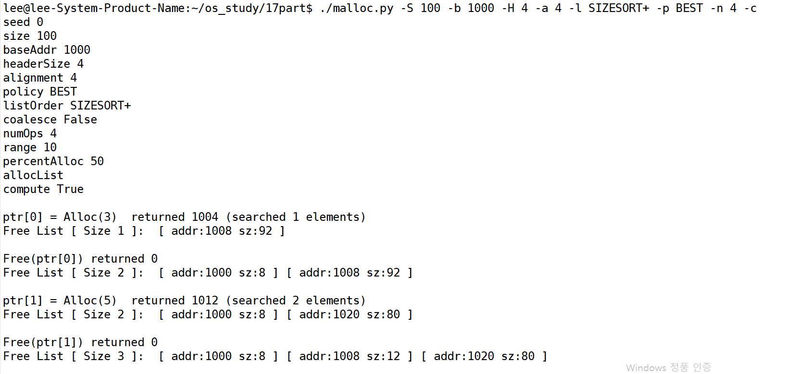
Homework of OSTEP
Chap 17. Free Space Management
Free Space 관리 simulation

Slide 7
Homework of OSTEP
Chap 19. Translation Lookaside Buffers
fds
write a program and measure the size and cost of accessing a TLB
Chap 20. Advanced Page Tables
check how a multi-level page table works by running paging-multilevel-translate.py program
Chap 21. Swapping: Mechanisms
using a tool with vmstat, trace memory, CPU, and I/O usage.
Chap 22. Swapping: Policies
Simulate different page-replacement policies by running paging-policy.py program

Slide 8
Chap 22. Swapping: Policies
When little memory is free
Memory pressure forces OS for paging out to make room for actively-used pages
Replacement policy: decide which page (or pages) to evict
Optimal replacement policy
Evict a page that will be accessed furthest in the future
Best replacement policy, comparison purpose
FIFO (First In First Out)
Evict a page that was brought into memory for the first time
Not considering locality
LRU (Least Recently Used)
Evict a page that was accessed oldest in the past
Considering temporal locality

Slide 9
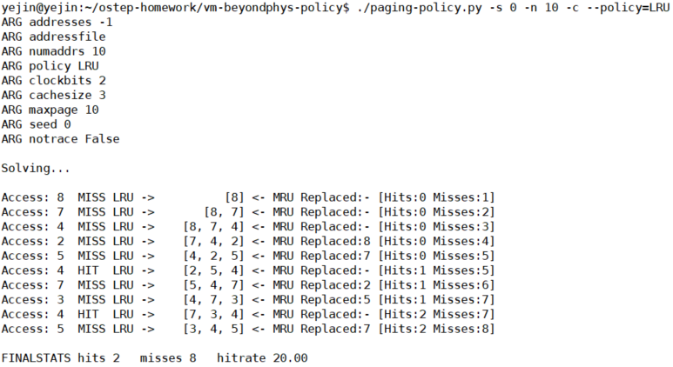
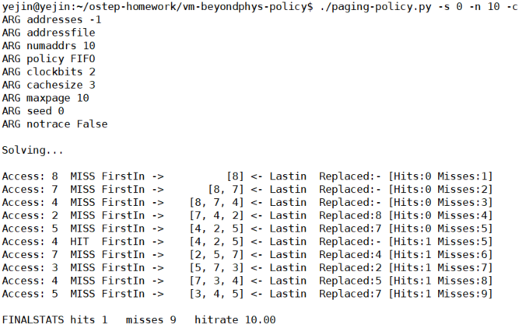
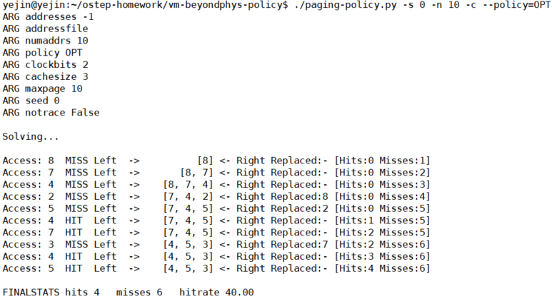
Homework of OSTEP
Paging-policy
1. Change the policy from FIFO, to LRU, to OPT and compute whether each access are hits or misses.
Cache size: 3 frames
Reference string: 8 7 4 2 5 4 7 3 4 5
Number of addrs: 10
LRU
LRU
FIFO
MRU
OPT

Slide 10
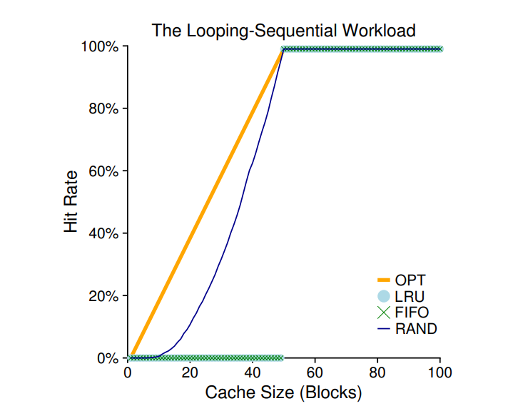
Homework of OSTEP
Paging-policy
2. For a cache size 5, generate worst-case address reference streams for FIFO and LRU. (worst-case reference streams cause the most misses possible)
Workload analysis
Loop workload: LRU==FIFO < RAND
- Algorithms of LRU and FIFO kick out older pages under a looping-sequential workload
- older pages are accessed sooner than the pages that the policies prefer to keep in cache

Slide 11
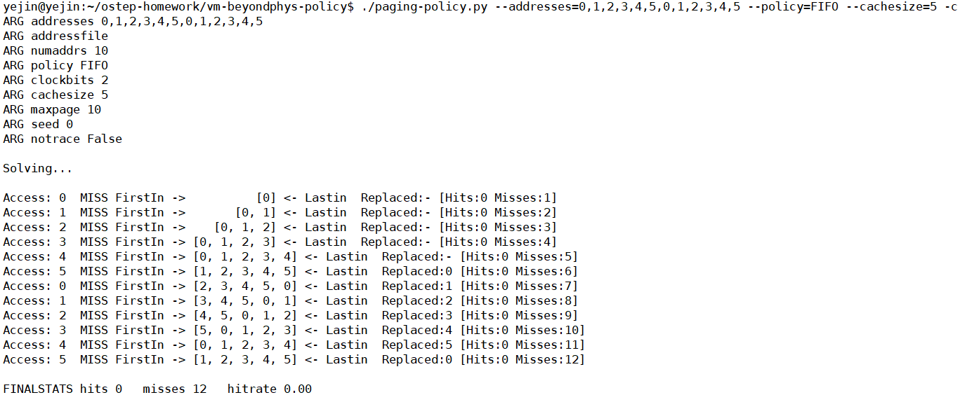
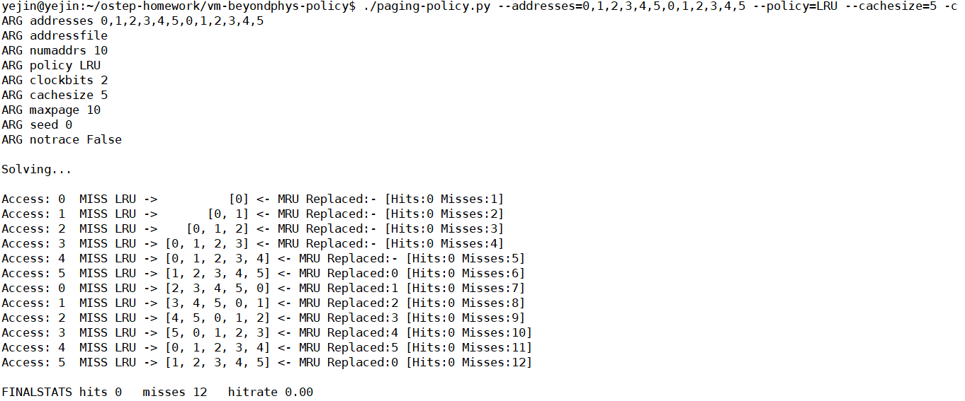
Homework of OSTEP
Paging-policy
2. For a cache size 5, generate worst-case address reference streams for FIFO and LRU. (worst-case reference streams cause the most misses possible)
FIFO
LRU
Capacity
miss

Slide 12
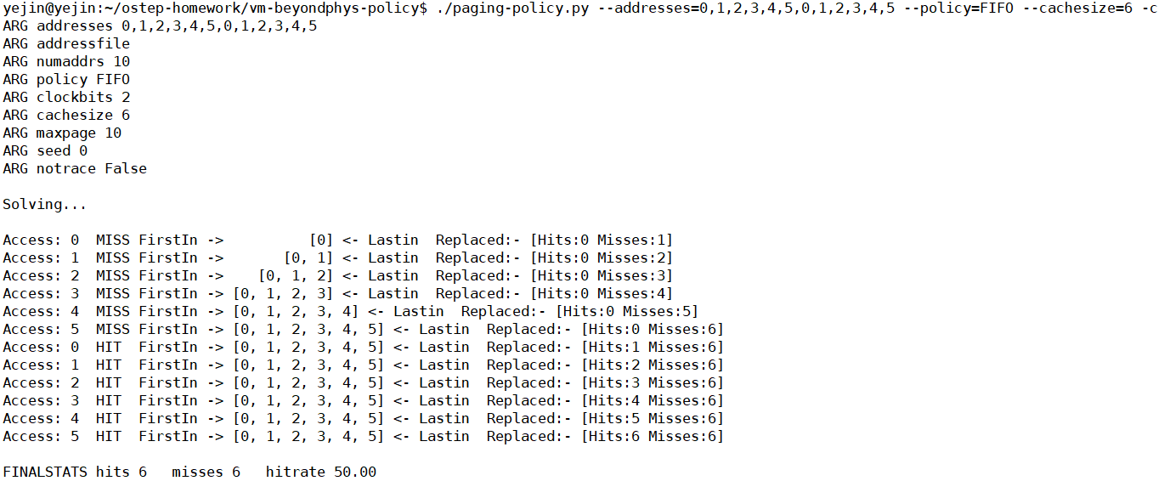
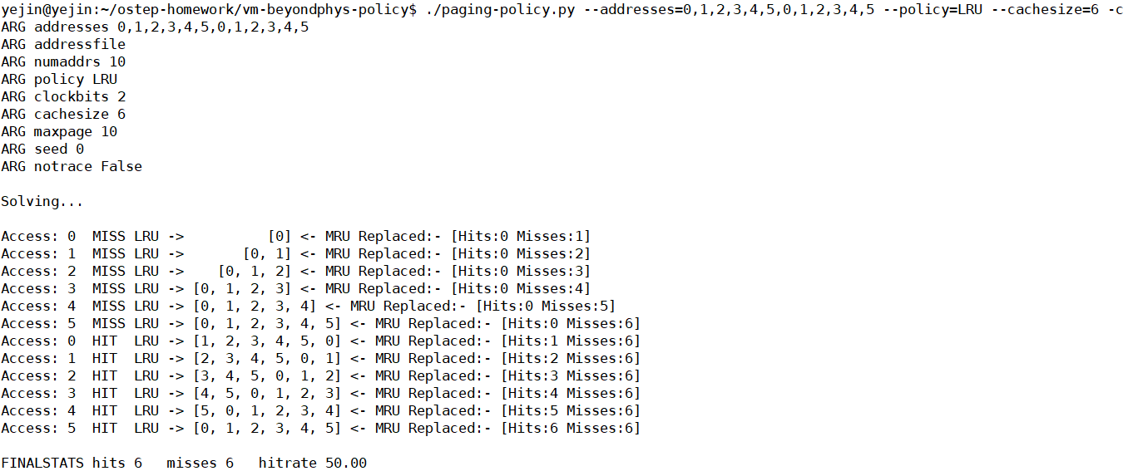
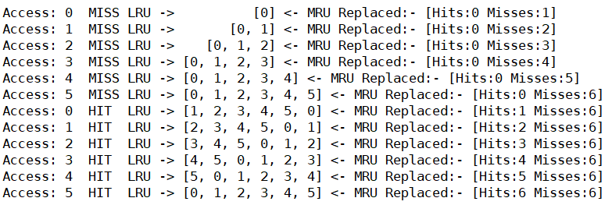
Homework of OSTEP
Paging-policy
2. For the worst case reference streams, how much bigger of a cache is needed to improve performance dramatically and approach OPT? -> 1
FIFO
LRU
cold-start miss

Slide 13

Homework of OSTEP
New 와 malloc 할당자 속도 비교
Realloc() 의 대표적 문제
Malloc : 함수 , new : 연산자
가장 큰 차이 : 생성자의 유무 ➔ new는 생성자를 호출하여 메모리 할당
➔ malloc 은 시스템 함수로서 함수 안에서 메모리 할당
# realloc() 실패시 null 값 반환
int * mem = malloc();
mem = realloc();
기존의 메모리가 할당되어 있는 포인터를 잃어버린다. ( dangling pointer)

